Slide 1
The Universal Viewer
Yoel Kortick
Senior Librarian

Slide 2
The Universal Viewer
Determining which file types the Universal Viewer will be used for

Slide 3
The Universal Viewer

Slide 4
The Universal Viewer
Typically a presentation of this nature would begin with a general introduction to what we are talking about: The Universal Viewer in Alma and Primo.
However in this case we will "let the facts speak for themselves" and begin with the configuration, see a sample record, and show how it works.
Let's go to the configuration.

Slide 5
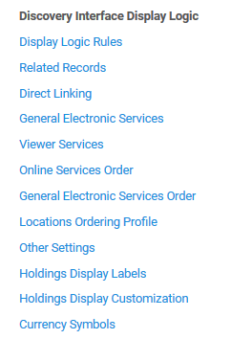
The Universal Viewer
The Viewer Services page is accessed at "Configuration > Fulfillment > Discovery Interface Display Logic > Viewer Services"

Slide 6
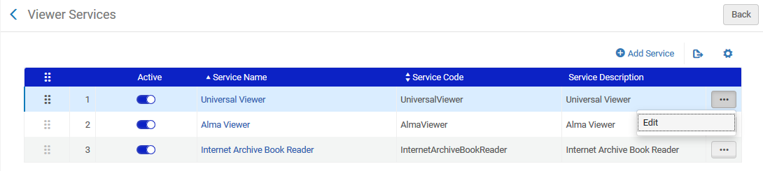
The Universal Viewer
Edit the Universal Viewer

Slide 7
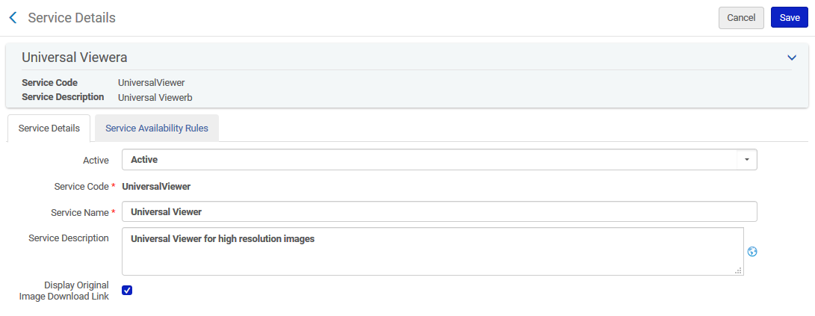
The Universal Viewer
The Service Code is hard coded.
The Service Name and Service Description can be changed as desired
The Service Description is the text that appears to the end user

Slide 8
The Universal Viewer
Select the 'Display Original Image Download Link' to display an additional radio button with the option to download "Original Source File" when the user chooses to download the file.
This additional radio button will also include both the file size and file type extension, aiding the user in his decision whether to download the original file.

Slide 9
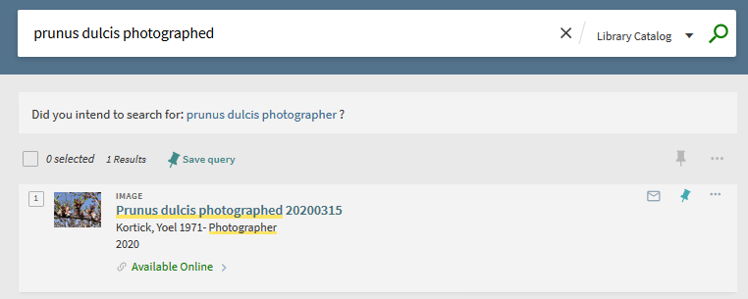
The Universal Viewer
We will click "Available Online"

Slide 10
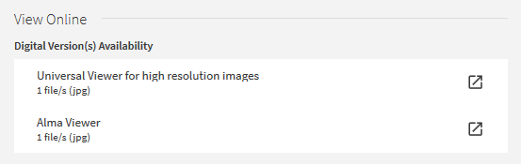
The Universal Viewer
This is the text we entered in the "Service Description"

Slide 11
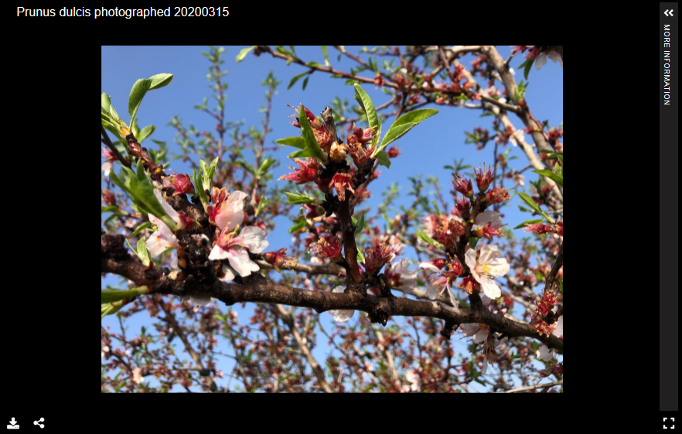
The Universal Viewer
Now we will click the download link

Slide 12
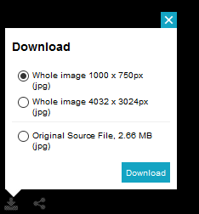
The Universal Viewer
We get these download links. The reason we have the option to download the "original source file" is because we checked "Display Original Image Download Link" in the configuration

Slide 13
The Universal Viewer
As we will see on the next slide the Universal Viewer includes the option to zoom in on a specific section of the image.
On the bottom right the user can move his or mouse to a specific part of the image and then zoom in directly on the section.

Slide 14
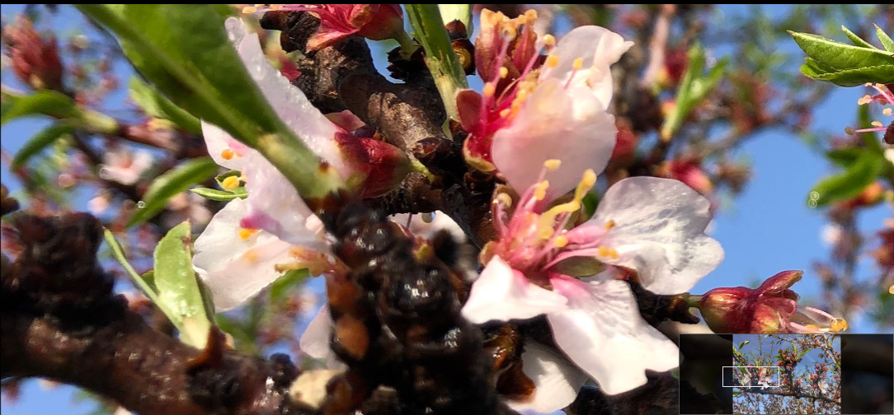
The Universal Viewer

Slide 15
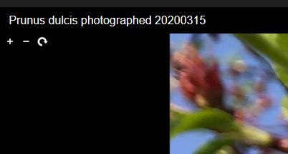
The Universal Viewer
It is also possible to zoom in and out via the + and – icons on top left, and also rotate the image

Slide 16
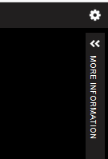
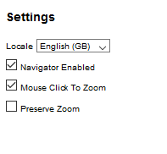
The Universal Viewer
It is also possible to zoom in via a mouse click if this option is configured (it is default)

Slide 17
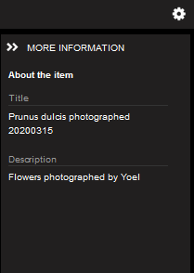
The Universal Viewer
Additional metadata from the file can also be displayed

Slide 18
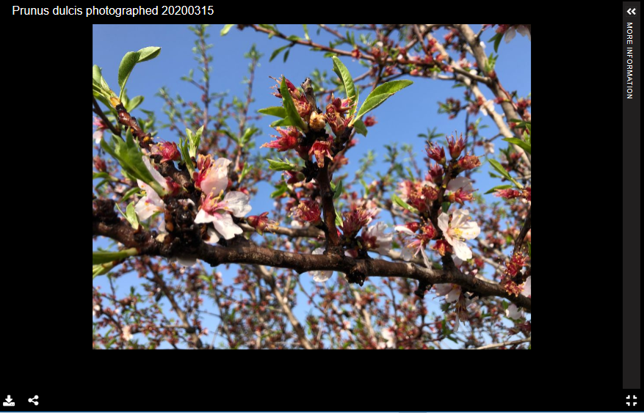
The Universal Viewer
It is also possible to share a link to the image via the Universal Viewer

Slide 19
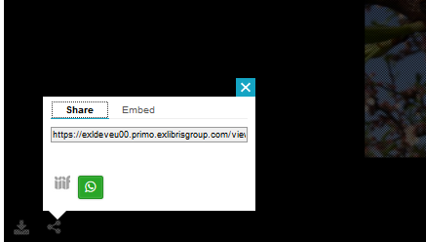
The Universal Viewer
The link to the image can then be copied and shared

Slide 20
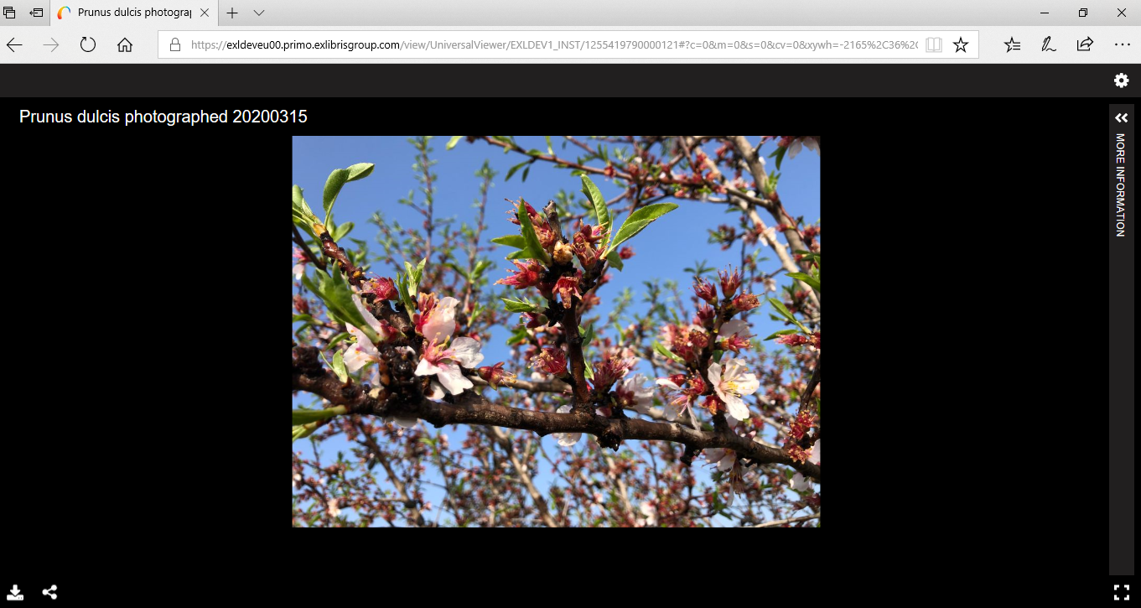
The Universal Viewer
The link will open the image in the universal viewer

Slide 21
Determining which file types the Universal Viewer will be used for

Slide 22
Determining which file types the Universal Viewer will be used for
In the scenario we did here the file was a jpg and the user had the option to choose the Universal Viewer.
In the next example (Anacamptis papilionacea) the file is type png and also the user has the option to choose the Universal Viewer.

Slide 23
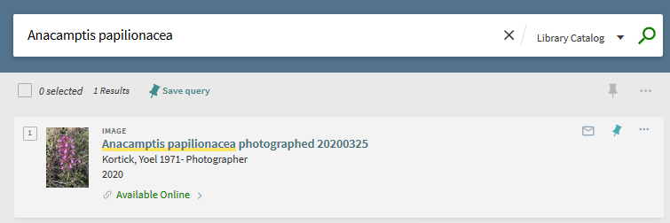
Determining which file types the Universal Viewer will be used for

Slide 24
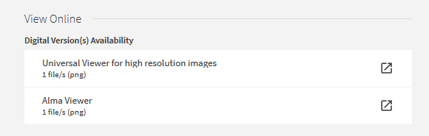
Determining which file types the Universal Viewer will be used for

Slide 25
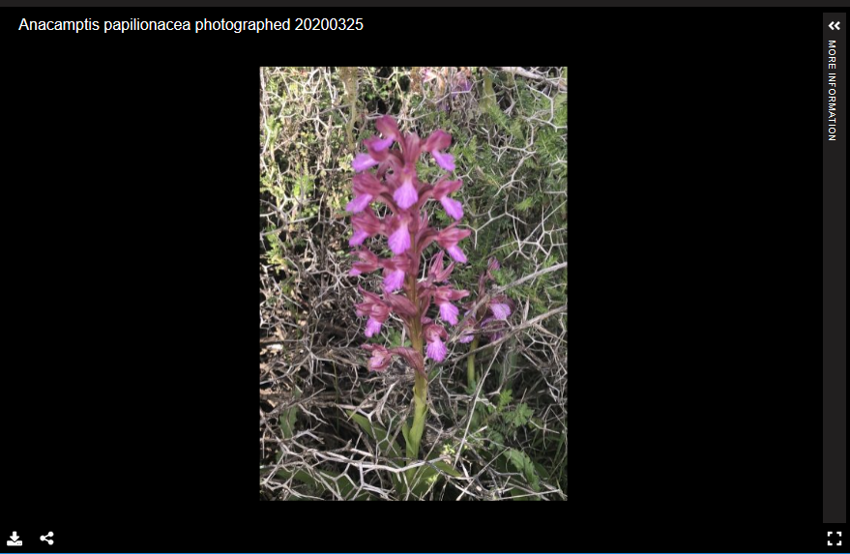
Determining which file types the Universal Viewer will be used for

Slide 26
Determining which file types the Universal Viewer will be used for
The reason that for both the jpg and png files (as well as for certain other file extension types) the Alma Universal Viewer was an option is because these file types were defined as "true" in the "Service Availability" tab of the Universal viewer.
Based on criteria including the material type of the bibliographic record, the usage type of the representation, and the file type of the representation, it is possible to determine which viewers will and will not appear for a file

Slide 27
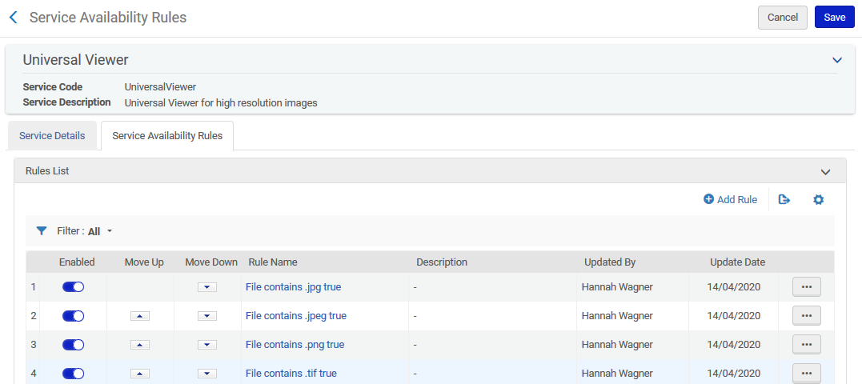
Determining which file types the Universal Viewer will be used for

Slide 28
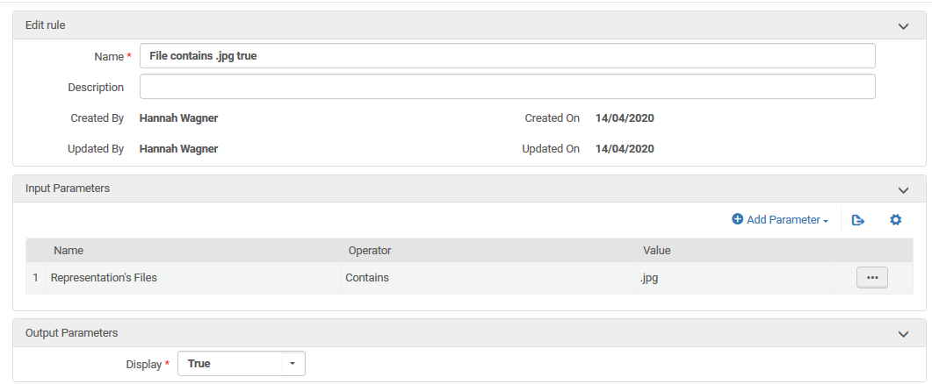
Determining which file types the Universal Viewer will be used for
In this rule for the Universal Viewer we state "If the Representation's files contains ".jpg" then display the viewer

Slide 29
Determining which file types the Universal Viewer will be used for
Note that it is also possible to use a regular expression to make one rule for multiple file types.
Thus for example, instead of one rule for .jpg and one rule for .jpeg and one rule for .bmp and one rule for .png and one rule for .tif and one rule for .tiff, there can be one all inclusive rule cover them all
This is the syntax:
\.bmp|\.png|\.jpg|\.tif|\.jpeg|\.tiff

Slide 30
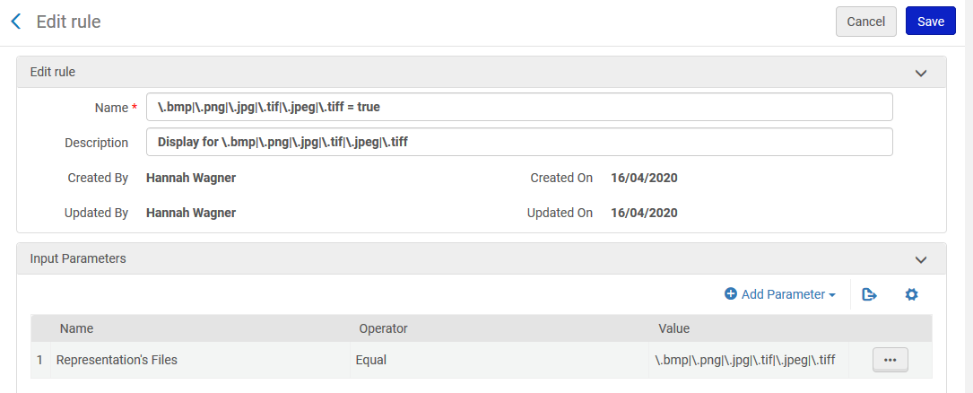
Determining which file types the Universal Viewer will be used for
One rule for multiple file types

Slide 31
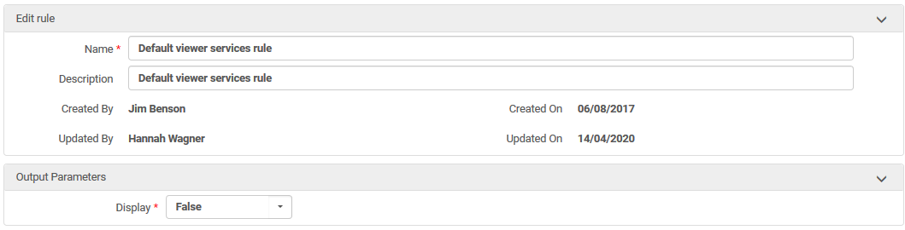
Determining which file types the Universal Viewer will be used for
The default rule for the Universal viewer, which occurs as the last rule after Alma has checked all custom-made rules, it states not to display the Universal Viewer

Slide 32
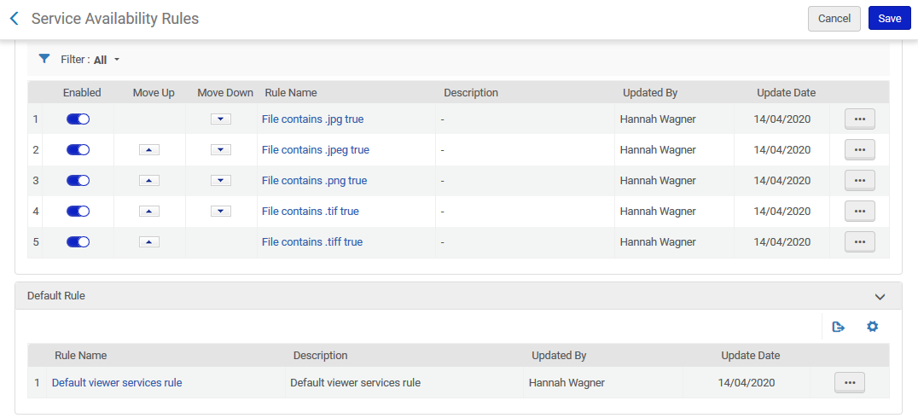
Determining which file types the Universal Viewer will be used for
First all these get checked
Then this gets checked

Slide 33
Thank you!
xxx@exlibrisgroup.com

